Slide 1

Spatial and storm-time dependence of electron microburst pitch angle isotropy
Presented by:
Conrad Meyer-Reed
Co-authors:
Lauren Blum, Mike Shumko

Slide 2

Abstract
This study uses electron count data from the SAMPEX satellite to calculate a qualitative measurement of electron pitch angle isotropy associated with microbursts
Spatial and storm-time dependence is determined by analyzing trends in microburst isotropy with respect to microburst magnitude, L-Shell, MLT, Dst, and AE
Information about electron population pitch angle isotropy will contribute to our understanding of electron loss processes in the Earth’s radiation belts

Slide 3
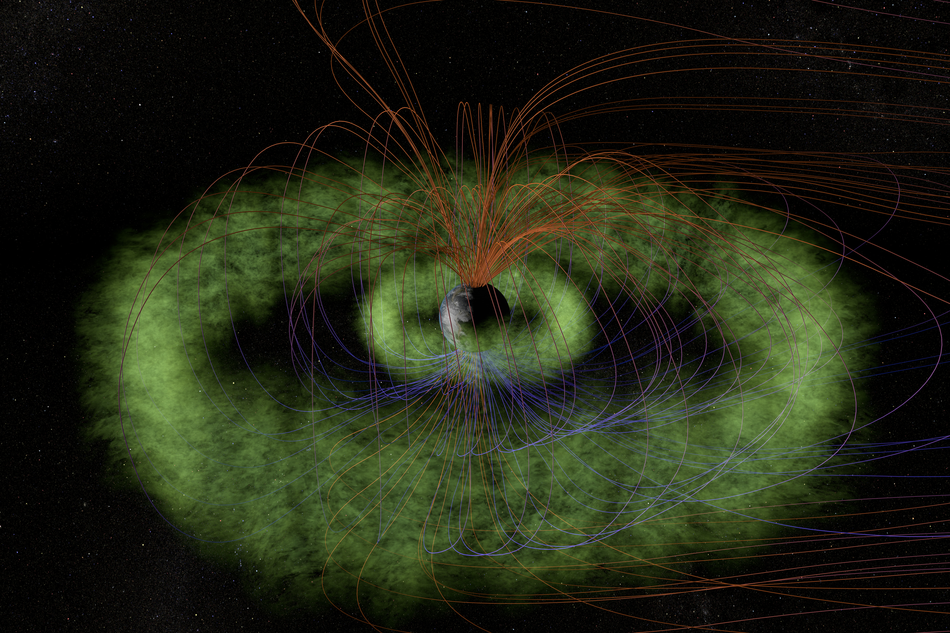
Outline
Introduction
Mission Background
Statistical Year Study
Storm-time Epoch Analysis
Conclusions
(From T. Benesch and J. Carns)

Slide 4
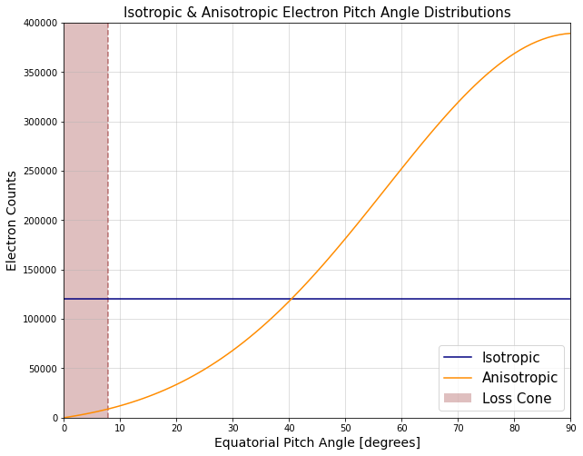
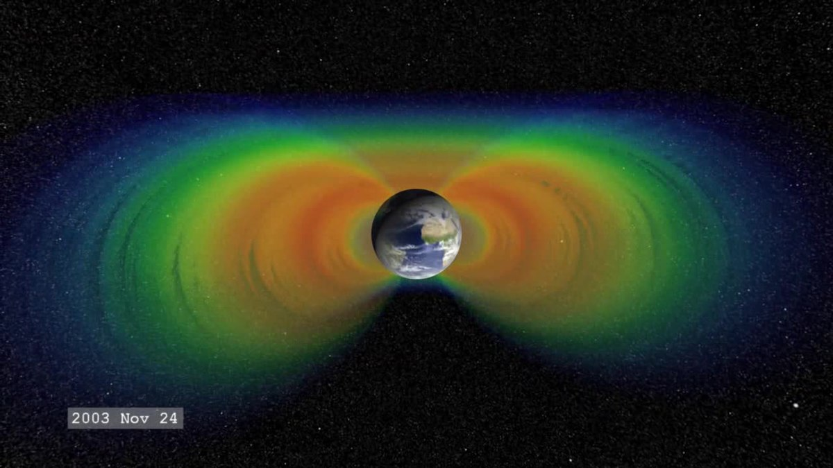
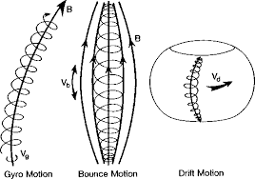
Introduction
The Earth’s radiation belts are composed of electrons interacting with the planetary magnetic field in 3 main motions:
Gyro motion (~1 ms)
Bounce motion (~0.1-1.0 s)
Drift motion (~1-10 min)
Pitch angle isotropy is defined by how electron population velocity pitch angles are distributed:
Isotropic: Pitch angles are pointed everywhere equally
Anisotropic: Pitch angles are pointed unevenly
(From Yuting Ng, 2013)
(From Wikipedia)

Slide 5
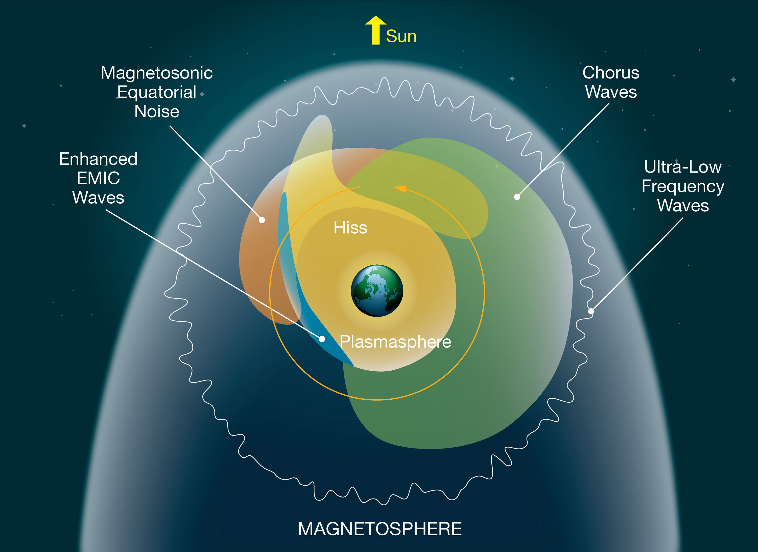
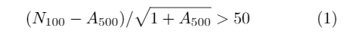
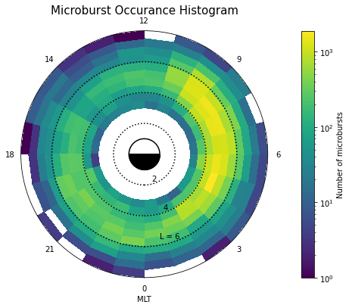
Introduction
Microburst detection algorithm:
(From O’Brien et al, 2003)
(From NASA)
Microbursts:
<1s duration streams of MeV-energy electrons often observed in the auroral regions of the inner magnetosphere
Microbursts have been previously associated with chorus wave activity
Most frequent in the morning magnetic local time region

Slide 6
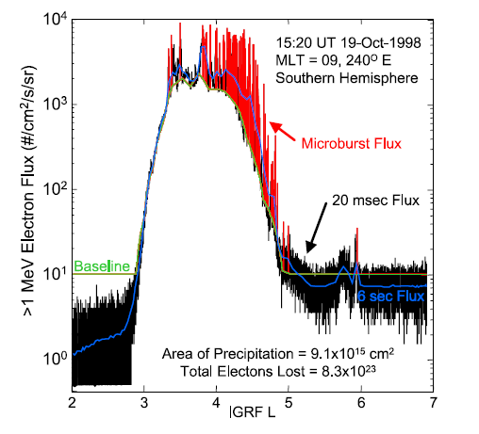
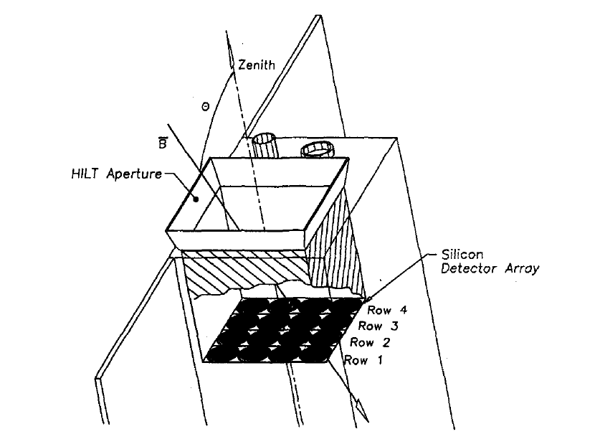
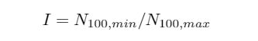
Mission Background
SAMPEX satellite collected information about particles in the Earth’s radiation belts in near polar orbit from 1992-2012
First spacecraft in the NASA Small Explorer program
(From O’Brien et al, 2004)
HILT instrument onboard the SAMPEX satellite consisted of a 4x4 Silicon detector array that recorded >1 MeV electron counts
Ratio of electron counts from detector rows 1 and 4 gives pitch angle isotropy:
Iso = 0 -> Anisotropic
Iso = 1 -> Isotropic
Isotropy Index Calculation:
(From Blake et al, 1996)

Slide 7
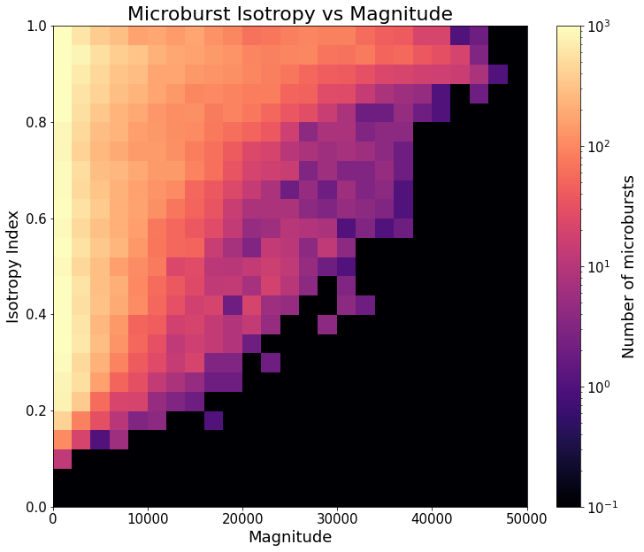
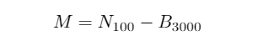
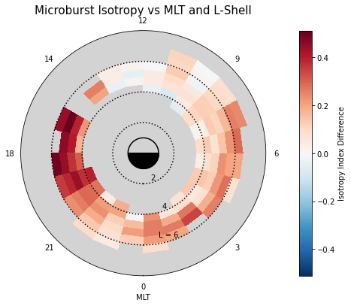
Statistical Year Study
Methods:
SAMPEX electron counts data selected from the year 1993
Analysis of correlations between isotropy index, microburst magnitude, and spatial parameters
Microburst magnitude calculation:
Results:
Positive correlation between microburst isotropy index and microburst magnitude:
Low magnitude: 0.2 – 1.0 isotropy index
High magnitude: ~1.0 isotropy index
High isotropy difference in the evening MLT range, medium isotropy in the midnight-morning MLT range, and low isotropy in the noon MLT range
Figure 1
(From O’Brien et al, 2003)
Figure 2

Slide 8
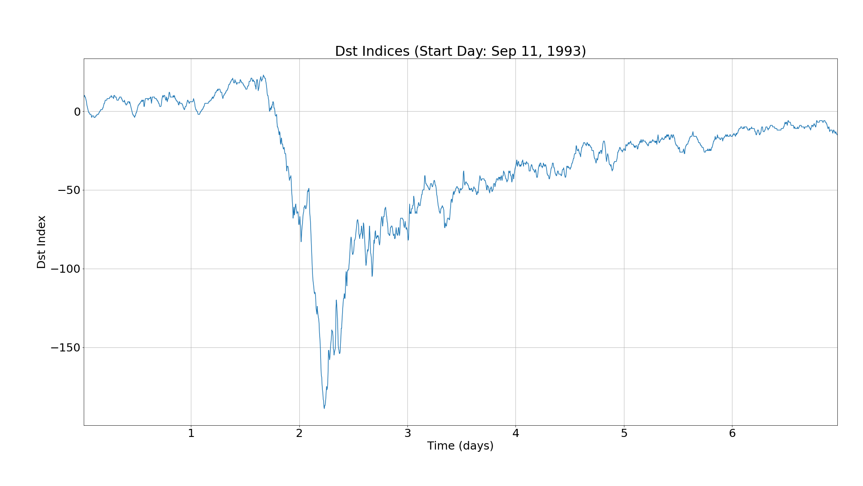
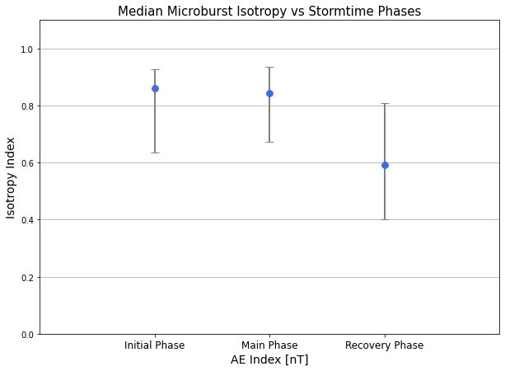
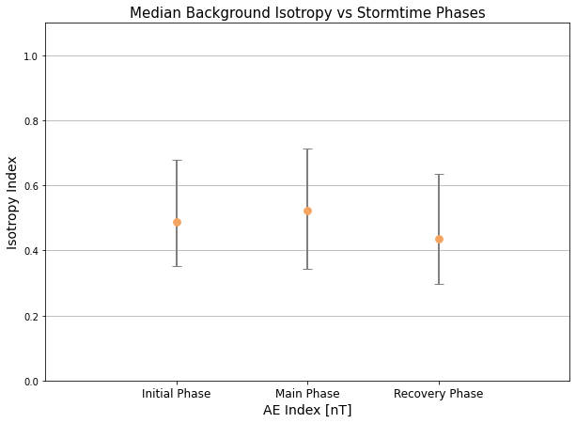
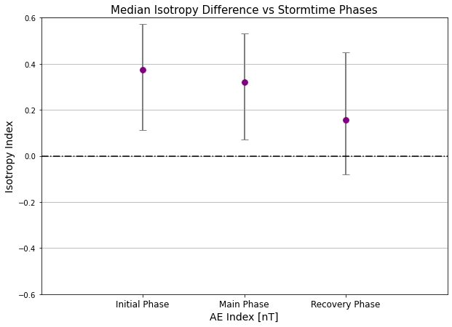
Storm-time Epoch Analysis
Methods:
Out of the 9 geomagnetic storms from 1993 with Dst_{min} < 100 nT, 6 storms with typical Dst profiles were selected for our analysis
Analysis of storm-time dependence of median microburst isotropy for initial, main, and recovery phases storms
Results:
Negative trend in median isotropy difference can be seen as storm phases progress
Figure 3
Figure 4
Figure 5

Slide 9
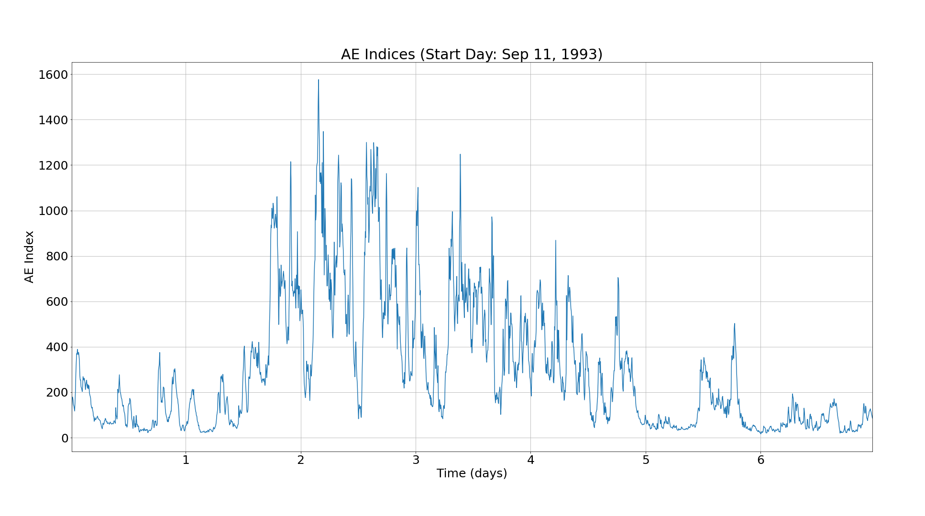
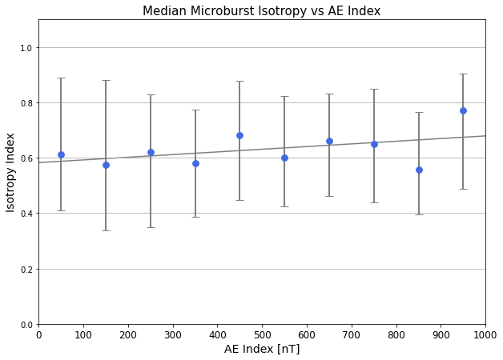
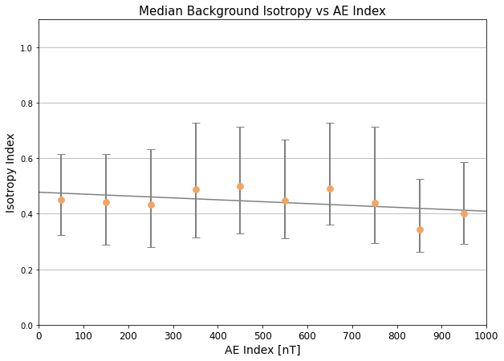
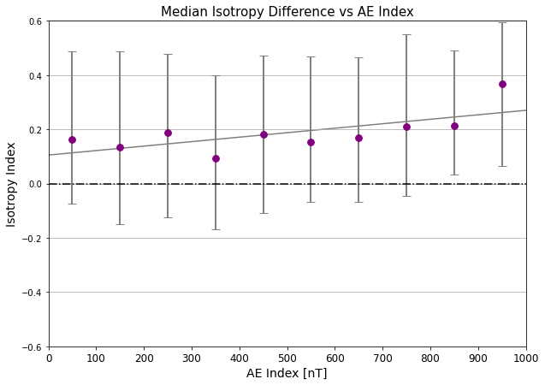
Storm-time Epoch Analysis
Methods:
Out of the 9 geomagnetic storms from 1993 with Dst_{min} < 100 nT, 6 storms with typical Dst profiles were selected for our analysis
Analysis of median microburst isotropy vs binned AE indices
Results:
Inconclusive results due to large spread in isotropy index median values (error bars show 25th and 75th percentiles)
Figure 6
Figure 7
Figure 8

Slide 10
Conclusions
Takeaways:
High isotropy corresponds to more electron precipitation; low isotropy corresponds to less electron precipitation
Low magnitude microbursts are widely varying in isotropy; high magnitude microbursts are more isotropic
The microburst isotropy compared to background is highest in the evening magnetic local time region and lowest in the noon region
The microburst isotropy compared to background is highest during the initial phase and lowest during the recovery phase of intense geomagnetic storms
Implications:
Although microbursts have been previously associated with chorus wave activity in the morning magnetic local time region, EMIC wave activity could be responsible for small amounts of highly isotropic microbursts in the evening magnetic local time region
Microburst isotropy is highest at the onset of geomagnetic storms, however this study has not found a strong correlation between microburst isotropy and magnitude of geomagnetic indices

Slide 11
Acknowledgements
Many thanks to:
Professor Lauren Blum for mentoring me throughout my time researching at LASP
Mike Shumko for providing feedback about my research and helping me with any coding questions I had
Contact information:
Email: Conrad.Meyer-reed@colorado.edu
Cell: (574) 538-8023

Slide 12
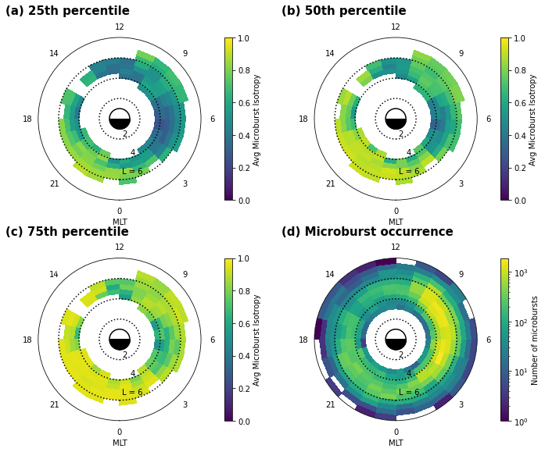
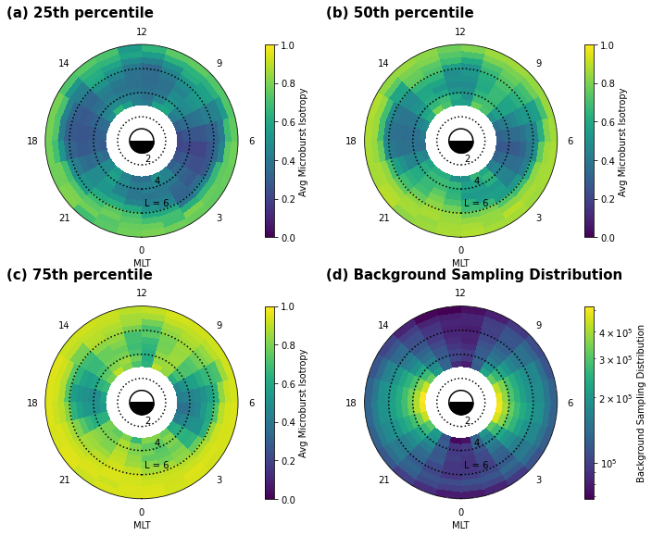
Extra Info Slide

